Slide 1

Probabilistic Weather Forecasting
CNNs & LSTMs with Proper Scoring Rules
Advanced Weather Forecasting Lecture Series

Slide 2
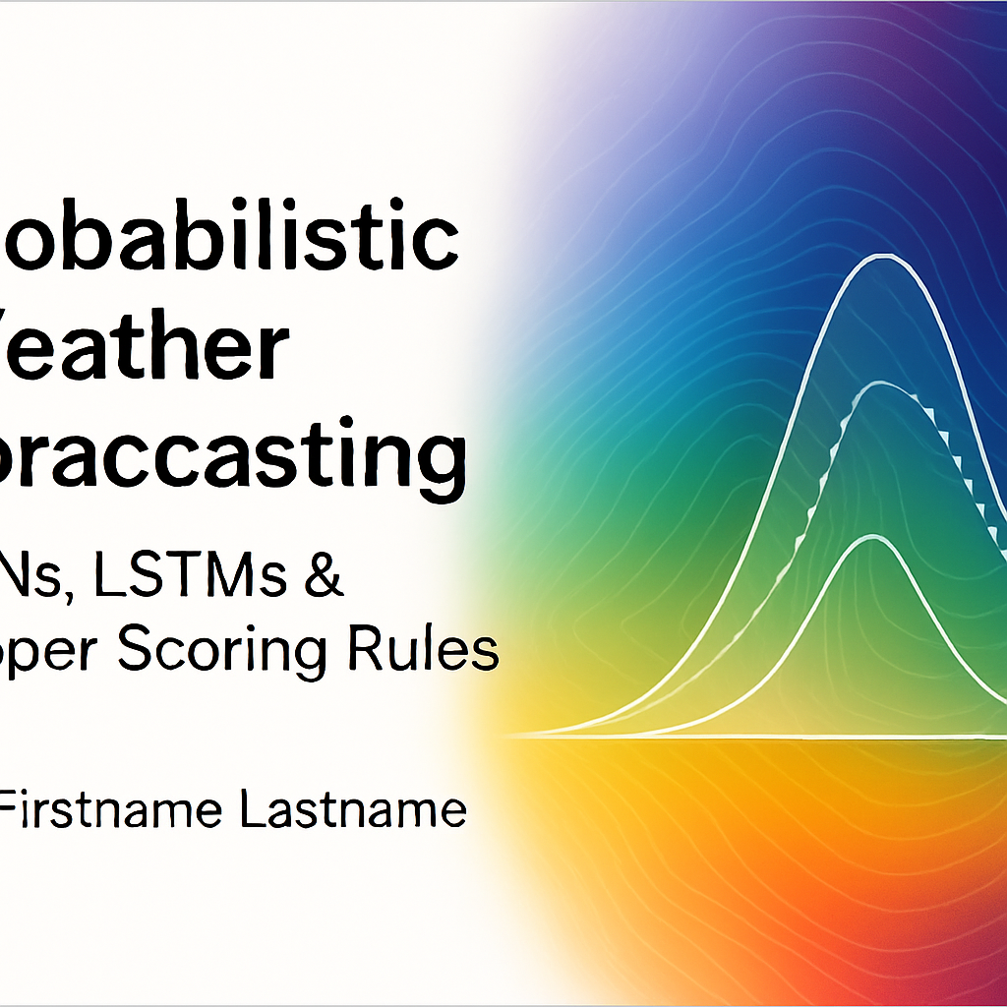
Lecture Outline
1. Motivation & Calibration
2. Proper scoring rules: Brier, Log, CRPS
3. Calibration & sharpness diagnostics
4. CNN architectures for probabilistic outputs
5. LSTM architectures for probabilistic outputs
6. Manual & framework implementations
7. Training results & calibration diagrams
8. Ensembles, hyperparameters & variants
9. Applications & best practices
10. Summary & further reading

Slide 3
Motivation & Calibration
Deterministic forecasts provide a single point estimate
Probabilistic forecasts assign a distribution to the future – essential for risk‑aware decisions
Calibration measures statistical consistency between predicted and observed distributions
Sharpness reflects the concentration of the predictive distribution; the goal is sharp and calibrated forecasts
Distribution
Point
[1]

Slide 4
Proper Scoring Rules
Scoring rules evaluate probabilistic forecasts by comparing the predicted distribution to the observed value.
A scoring rule is strictly proper if the expected score is minimized when the forecast distribution equals the true distribution.
Proper scoring rules encourage calibration and discourage hedging.
Rule | Definition | Properties
Brier | B(r,i)=∑(y_j−r_j)^2 | Quadratic, strictly proper, for discrete outcomes
Log | L(D,y)=−ln f_D(y) | Strictly proper, sensitive to tail probabilities
CRPS | ∫ (F_D(x)−H(x−y))^2 dx | Strictly proper, extension of MAE to distributions
[1] [2] [3] [4]

Slide 5
Brier Score
Measures squared error between predicted probabilities and outcomes for binary/multiclass events.
For a forecast p and outcome y, B = (y−p)^2 + ((1−y) − (1−p))^2.
Mean Brier Score = 0.150
[2]

Slide 6
Logarithmic Score
Evaluates the log likelihood of the observation under the predicted distribution.
For a density f_D(y), LogScore = −ln f_D(y).
Sensitive to tail probabilities; encourages accurate distribution tails.
mu | sigma | y | LogScore
4.5 | 0.8 | 5 | 0.891
[3]

Slide 7
Continuous Ranked Probability Score
Generalises the MAE to probabilistic forecasts; widely used in meteorology.
Defined for forecast CDF F_D and observation y as CRPS = ∫(F_D(x) − H(x−y))^2 dx.
Alternative expectation form: E|X−y| − 0.5 E|X−X|.
Step at y
Forecast CDF
[4]

Slide 8
CRPS: Numerical Example
Consider a forecast with two equiprobable outcomes {2, 5} and an observation y = 4.
Using the expectation form: CRPS = E|X−y| − 0.5 E|X−X|.
Computed CRPS = 0.750
Outcome | |X−y| | Pairwise terms
2 | 2.0 | 3.0, 0.0
5 | 1.0 | 3.0, 0.0
[4]

Slide 9
Calibration & Sharpness
Reliability: predicted probabilities match observed frequencies.
Sharpness: predictive distributions are as concentrated as possible.
Aim: reliability diagrams close to diagonal and narrow prediction intervals.
Reliability diagram
[1]

Slide 10
CNN Architecture for Probabilistic Forecasting
Input
series
Conv
filters
Pooling
Dense→
mu, sigma
1D CNNs learn local temporal patterns in weather sequences.
Final dense layer outputs parameters of a probability distribution (e.g., mean and variance of a Gaussian).
Loss functions built from scoring rules train the network to produce calibrated distributions.
[1]

Slide 11
Probabilistic Output Layers
Parameterize output distribution using neural network.
For Gaussian outputs: network outputs mu and log sigma → sigma = exp(log sigma).
NLL loss = 0.5 ((y−mu)/sigma)^2 + ln sigma + const.
CRPS loss can be computed in closed form for Gaussian distributions.
mu = f(x; theta) sigma = exp(g(x; theta)) NLL(mu,sigma) = 0.5 ((y−mu)/sigma)^2 + ln sigma + const
[3] [4]

Slide 12
Numeric Examples: Brier & Log Scores
Forecast | p (Rain) | y | (y−p)^2
F1 | 0.2 | 0 | 0.040
F2 | 0.7 | 1 | 0.090
F3 | 0.4 | 0 | 0.160
F4 | 0.9 | 1 | 0.010
mu | sigma | y | NLL
4.5 | 0.8 | 5 | 0.891
Compare how different scoring rules penalize forecasts in a simple setting.
[2] [3]

Slide 13
LSTM Architecture for Probabilistic Forecasting
LSTM
LSTM
LSTM
LSTM
Dense→
mu, sigma
LSTMs capture long‑range temporal dependencies via gated units.
Similar to CNNs, a dense head outputs distribution parameters (mu, sigma).
Use scoring rule‑based losses (NLL, CRPS) to train for calibrated forecasts.
[1] [3]

Slide 14
Manual Implementation (NumPy)
# x: batch of input sequences
# y: batch of observations
# theta: weights of CNN
for epoch in range(E):
# forward pass: compute mu, sigma from CNN(x, theta)
mu, sigma = cnn_forward(x, theta)
# compute CRPS using closed form for Gaussian
loss = mean(crps_gaussian(mu, sigma, y))
# backward pass: compute gradients dloss/dtheta
grad = cnn_backward(x, mu, sigma, y)
# update weights
theta = theta - alpha * grad
Define forward pass to output mu and sigma.
Use closed‑form CRPS loss for Gaussian outputs.
Compute gradients with respect to weights by backpropagation.
Update parameters using gradient descent.
[4]

Slide 15
Framework Implementation
import tensorflow as tf
inputs = tf.keras.Input(shape=(seq_len, n_features))
x = tf.keras.layers.Conv1D(32, kernel_size=3, activation='relu')(inputs)
x = tf.keras.layers.GlobalAveragePooling1D()(x)
mu = tf.keras.layers.Dense(1)(x)
log_sigma = tf.keras.layers.Dense(1)(x)
sigma = tf.exp(log_sigma)
neg_log_like = tf.reduce_mean(0.5 * ((y - mu)/sigma)**2 + tf.math.log(sigma))
model = tf.keras.Model(inputs, [mu, sigma])
model.add_loss(neg_log_like)
model.compile(optimizer='adam')
Use high‑level libraries (Keras, PyTorch) to build models.
Custom loss functions implement proper scoring rules (e.g., NLL, CRPS).
Add multiple outputs (mu, sigma) and compute loss explicitly.
[3]

Slide 16
Training Results: Manual Models
Loss curves (manual models)
Predicted temperature distribution vs observations
[4]

Slide 17
Training Results: Framework Models
CRPS loss curves (framework)
Predicted rainfall distribution vs observations
[4]

Slide 18
Calibration Diagnostics
Reliability diagram
PIT histogram
Diagnostics help assess calibration (reliability) and distributional shape (PIT).
[1]

Slide 19
Ensembles & Model Combination
Averaging multiple models can improve calibration and sharpness.
Use ensembles of CNNs/LSTMs trained with different initialisations.
Alternatively combine deterministic models (mean forecasts) with probabilistic postprocessing (e.g., quantile regression).
Average CRPS (lower is better)
[4]

Slide 20
Hyperparameters & Tuning
Window size: number of past days fed into the network.
Network depth & filters: number of convolutional layers and LSTM units.
Output distribution type: Gaussian, mixture, quantile regression.
Scoring rule: choose NLL, CRPS, or quantile loss depending on the application.
Learning rate & regularisation: optimize using validation data.
Effect of mixture components on CRPS
[4]

Slide 21
Variants & Advanced Models
Mixture Density Networks (MDN): output mixture weights, means & variances.
Quantile Regression Networks: output specific quantiles using pinball loss.
Generative models (GANs/VAEs): sample entire distributions.
Bayesian neural networks: place priors over weights to capture uncertainty.
Accuracy vs Calibration of variants
[3] [4]

Slide 22
Applications in Weather Forecasting
Temperature & precipitation forecasting for energy demand.
Wind speed forecasts for renewable power integration.
Flood risk and extreme event prediction using tail‑focused distributions.
Ensemble postprocessing for numerical weather prediction models.
Forecast horizon with uncertainty
[4]

Slide 23
Limitations & Challenges
Heavy tails and extreme events are difficult to model accurately.
Probabilistic calibration may fail under distributional shift.
Computational cost of training CRPS/NLL losses for large models.
Interpretability and communicating probabilistic forecasts to stakeholders.
Distribution tail probabilities
[4]

Slide 24
Best Practices
Normalize inputs and standardise target variables.
Use early stopping and cross‑validation to prevent overfitting.
Evaluate with multiple scoring rules and calibration diagnostics.
Calibrate deterministic models using isotonic regression or Platt scaling when appropriate.
Communicate probabilistic forecasts with clear visualisations (intervals, fan charts, reliability diagrams).
[1]

Slide 25
Case Study: Probabilistic Forecast of Daily Temperature
Use a CNN trained with CRPS to forecast daily temperature.
Compare predicted mean and 95% interval against observations.
Evaluate calibration using reliability diagrams and PIT histograms.
[4]

Slide 26
Comparison with LSTM & Transformer Models
Model | Strengths | Limitations
LSTM | Captures long‑range dependencies; simple to implement | May overfit; training slower; calibration depends on output layer
Transformer | Highly parallel; captures global context | Requires larger data; heavier compute; may need calibration tricks
CNN | Efficient; learns local patterns; robust to noise | Limited long‑range context; may need multiple layers
GNN | Handles spatial relations (stations); message passing | Graph construction overhead; more complex frameworks
[1] [4]

Slide 27
Summary
Probabilistic forecasts quantify uncertainty and enable risk‑aware decisions.
Proper scoring rules (Brier, Log, CRPS) provide objective loss functions that encourage calibration.
CNNs and LSTMs can be extended to output distribution parameters and trained with these scoring rules.
Calibration diagnostics (reliability diagrams, PIT histograms) are essential to evaluate forecasts.
Ensembles, proper hyperparameter tuning, and advanced models further improve probabilistic forecasts.
[2] [3] [4]

Slide 28
Further Reading & Resources
Gneiting, T. & Raftery, A. (2007) – Strictly proper scoring rules and calibration.
Brier, G. W. (1950) – Verification of forecasts expressed in terms of probability.
Wikipedia: Scoring rule – definitions of Brier, Log and CRPS(en.wikipedia.org)(en.wikipedia.org).
Probabilistic Forecasting in R package scoringRules.
ESRL tutorial on reliability diagrams and PIT histograms.
[2] [3] [4]

Slide 29
Questions & Discussion
Feel free to ask about implementing scoring rules, calibration techniques, or model architectures.
[1]

Slide 30
Thank You!
Probabilistic Weather Forecasting Lecture
[1]

